Slide 1


Gold Price Analysis: When (in the future) to Buy/Sell Gold?
Ironhack Bootcamp mid-project by:
Muhammad Dimas Abdul Aziz Cakradewa
Vasco Reis
Data Analytics Full-Time Course
November 2022

Slide 2
introduction
Main Goal:
Forecasting the optimum times to sell or purchase gold
Direct-Impact Factors:
Supply and demand
Inflation
Interest rates
Political and economic instability
Dollar and other Rare-material value
General Tendencies

Slide 3
How did we reach the goal
Technical Analysis
Fundamental Analysis
The 3 Tendencies:
Economic cycle
Political cycle
Interest rate cycle
Merge the results
„The January Effect“
The creation of the prediction model

Slide 4
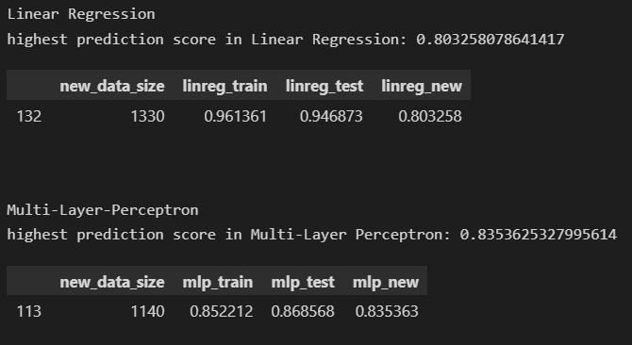
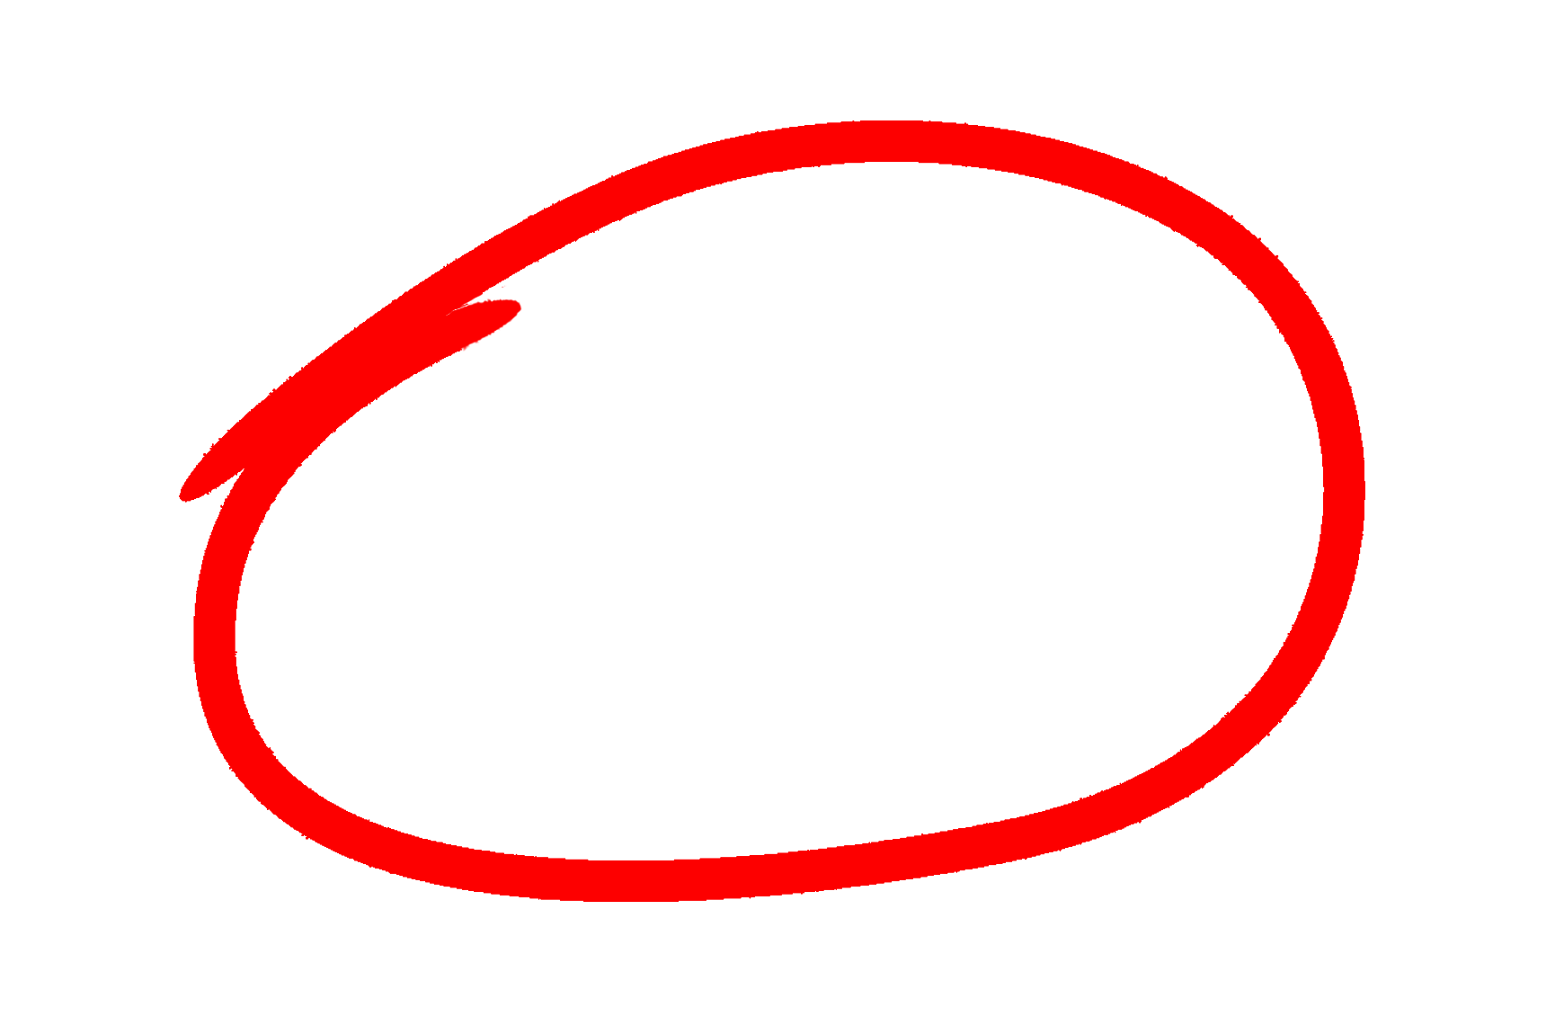
Our prediction model
Analyses all the previous referred factors put together,
analyses the fluctuation of the gold price, and
Provides tips to when to sell or buy gold with:
83% certainty

Slide 5
Project result
Technical side: write a code to predict with high accuracy
Assisting in decision-making for:
When to buy?
When to sell?
Price?
Take a look at the price comparison: prediction vs real

Slide 6
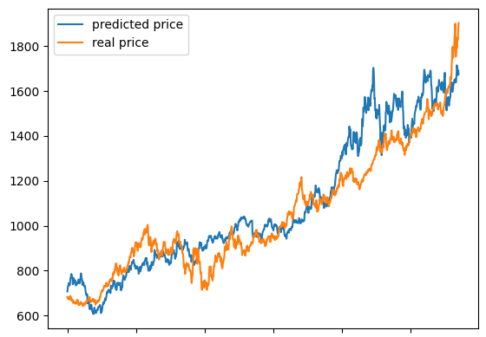

Slide 7
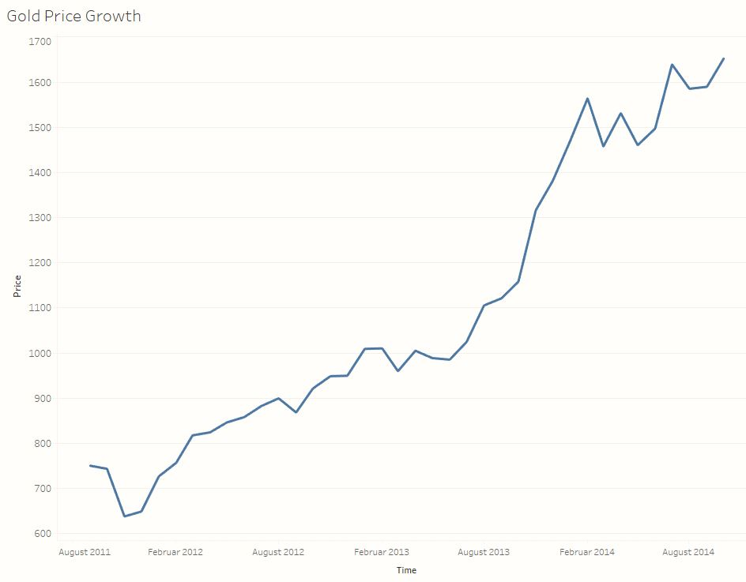

Slide 8
: suggested time to buy
When: February 2014
Price: 994$ per Oz.
When: August 2012
Price: 902$ per Oz.
When: November 2011
Price: 654$ per Oz.
When: March 2013
Price: 994$ per Oz.

Slide 9
When: February 2014
Price: 1564$ per Oz.
: suggested time to sell
When: July 2014
Price: 1639$ per Oz.
When: April 2013
Price: 1005$ per Oz.

Slide 10
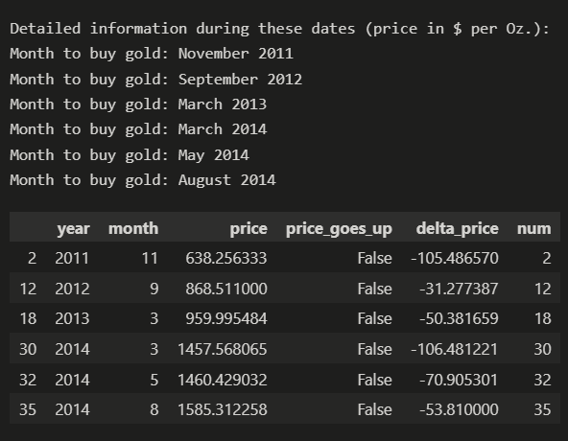
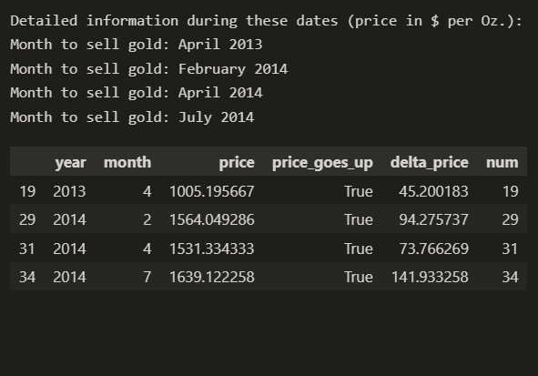
Buy/time suggestion as table

Slide 11


Thank you for your Attention!
www.linkedin.com/in/muhammad-dimas-a-a-cakradewa
https://www.linkedin.com/in/vasco-reis-b5107212a/

